Slide 1
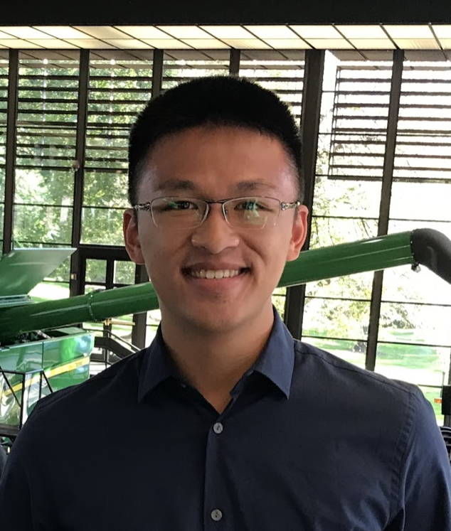





Honors college scholarly project:
Mechanical arm 3d simulator for education
Shao-Chieh Lien
Shristi Saraff
Wei-Chen Kao
Pei-Ching Lien
Po-hsun Chen
Software Architect & Team Leader
Software Developer
Algorithm Developer
Mechanical Engineer
Project Assistant
04/10/2021
1
Notes:
1

Slide 2
Outline
Introduction
Problem Statement
Proposed Solution
Deliverable
Simulator
Technical side of the Simulator
Coding Environment
Technical side of the Coding Environment
Project Demo
Future Work
4/12/21
2
Notes:
2

Slide 3
Introduction
Since the development of 5G and AI, the mechanical arm and robotics markets have been growing exponentially and are expected to play an important role in every household within the next 30 years.
The development of a mechanical arm requires cross-disciplinary students to master both the software and the hardware knowledge related to the mechanical arm.
In the future, students need to have sufficient robotic knowledge to contribute to the robotic industry.
4/12/21
3
Notes:
3

Slide 4
Problem Statement
The high cost of a mechanical arm creates a barrier for students to have access to it. (One industrial mechanical arm could cost more than USD 30,000)
Students could only acquire the conceptual understanding of the mechanical arm but lack real-life experience.
Lack of training and experience related to a mechanical arm leads to a higher rate of critical mistakes and hazard after the student enters the workforce.
Students need a place that allows them to safely implement their robotics knowledge that are taught in school into real life.
4/12/21
4
Notes:
4

Slide 5
Proposed Solution
A 3D simulator that could simulate a mechanical arm and provide a GUI for students to understand the robot’s architecture and provide a coding environment for students to learn robotic programming using high-level languages.
Meet two needs in one solution: - Computer Science students could learn mechanical arm architecture - Mechanical Engineering students could learn to program robots
Cheap and small size (<200 MB) suitable for educational use.
Low risk associated with application.
4/12/21
5
Notes:
5

Slide 6
Deliverable
An application for the educational 3D simulator and a coding environment for students to control the simulated mechanical arm
An open-source code and documentation include: - Open-source code: Both the simulator and the coding environment - High-level API & Coding Sample: For beginners to learn to control the simulated arm - Communication Protocol: For a contributor to extend the functionality using low-level language (Machine Code)
4/12/21
6
Notes:
6

Slide 7
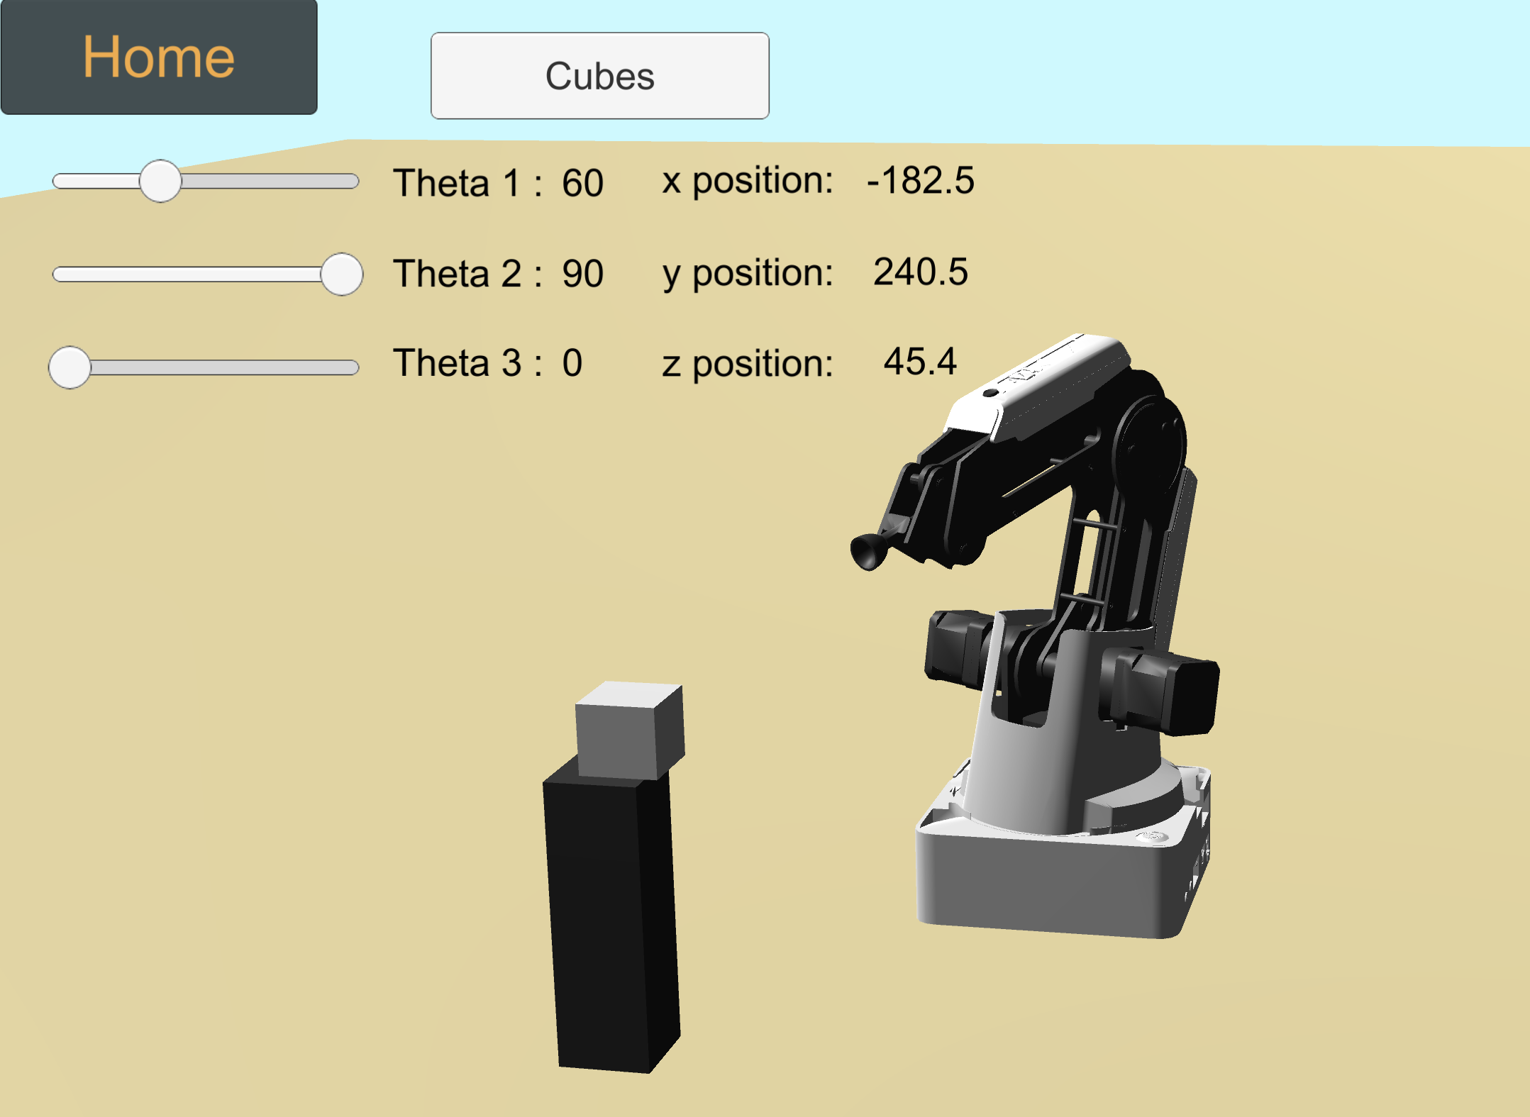
Simulator
Simulate a 3-axises mechanical arm.
Provide three sliders that could control the rotating angle of each motor on GUI.
Show the angle of each motor and the Cartesian coordinate position of the suction cup.
Provide simulated objects that allow the users to test the mechanical arm’s ability to grab object by the suction cup.
4/12/21
7
Notes:
7

Slide 8
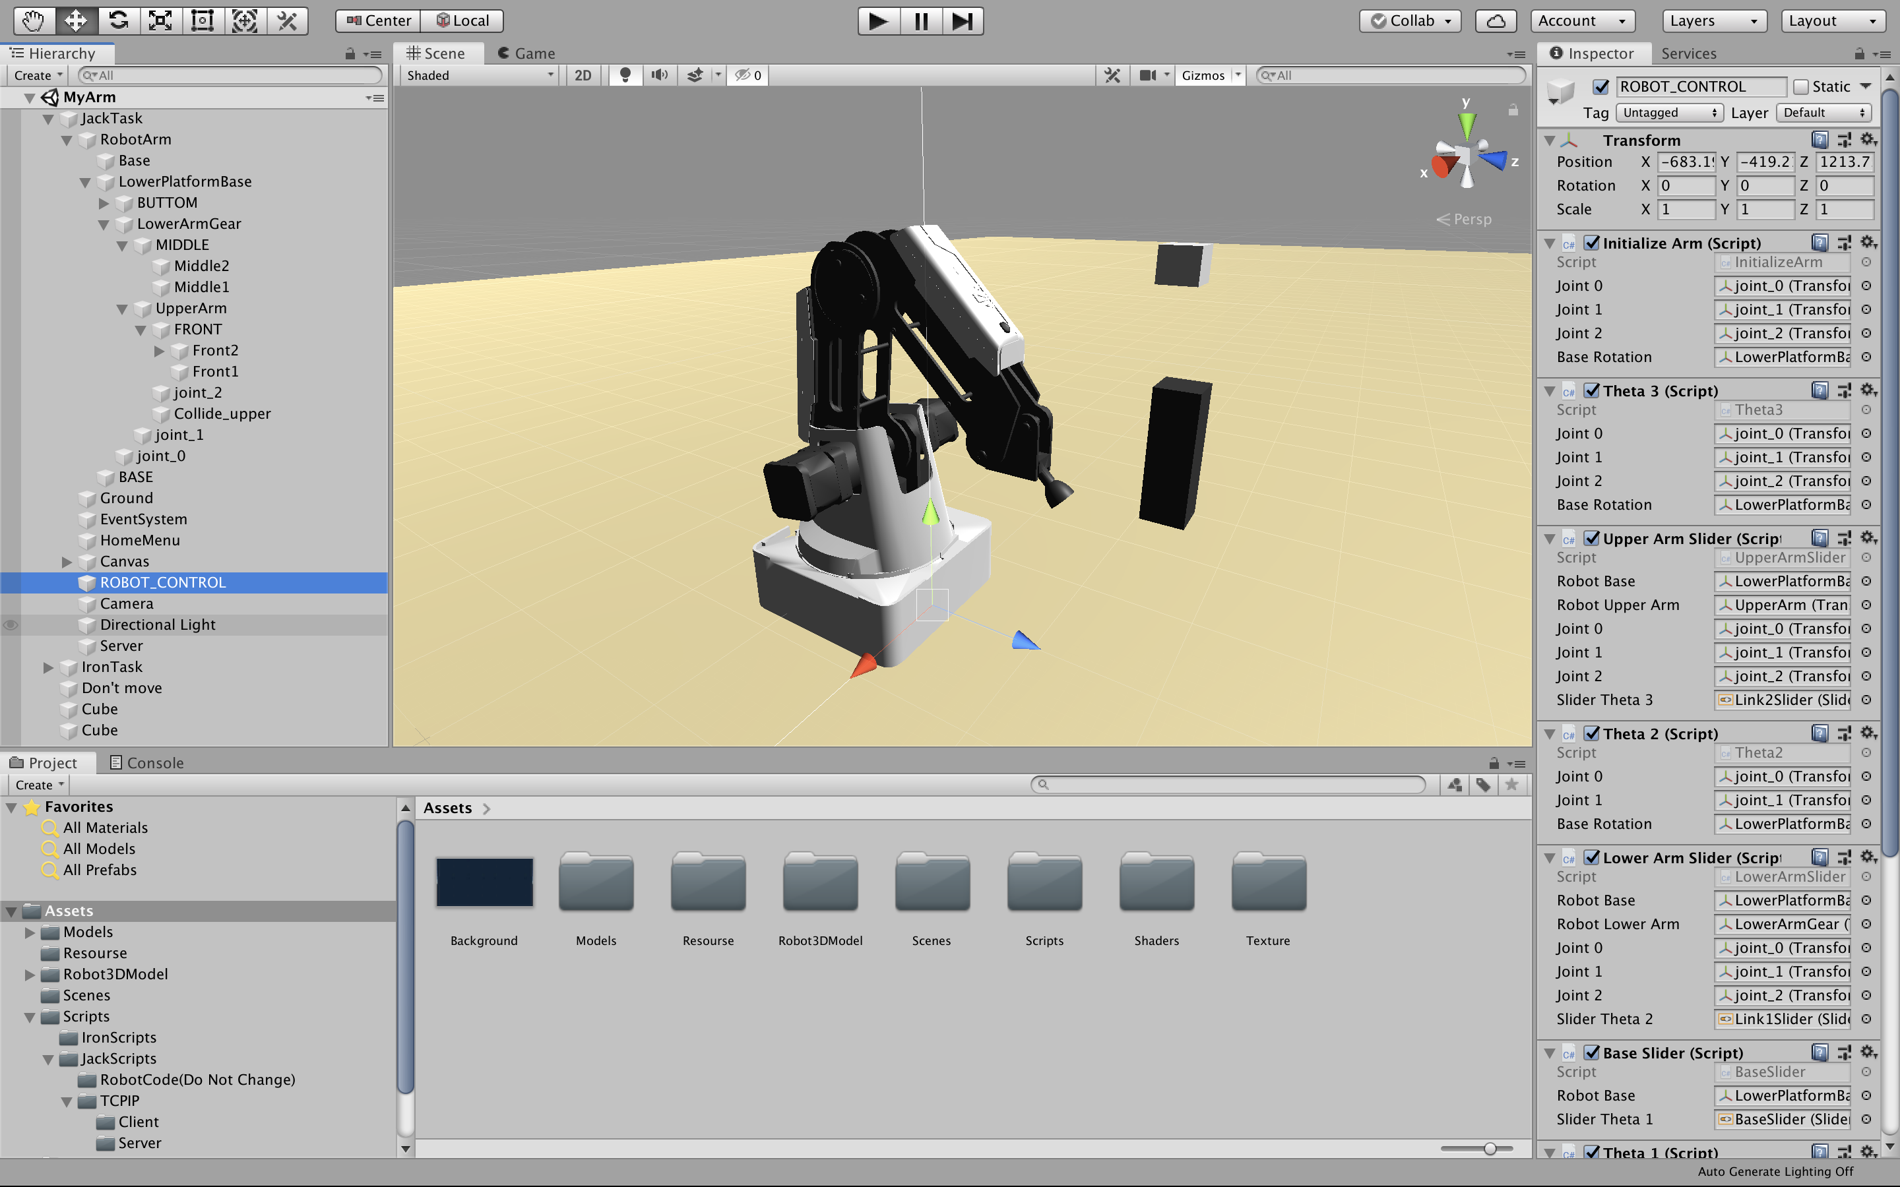
Technical Side of the Simulator
Made with Unity3D and built into a macOS App.
Separated the mechanical arm into four 3D major components, combined them with three motors and attached each object with C# script.
The simulator served as a server that listened to the machine code sent from the coding environment and rotated the motors, accordingly.
4/12/21
8
Notes:
8

Slide 9
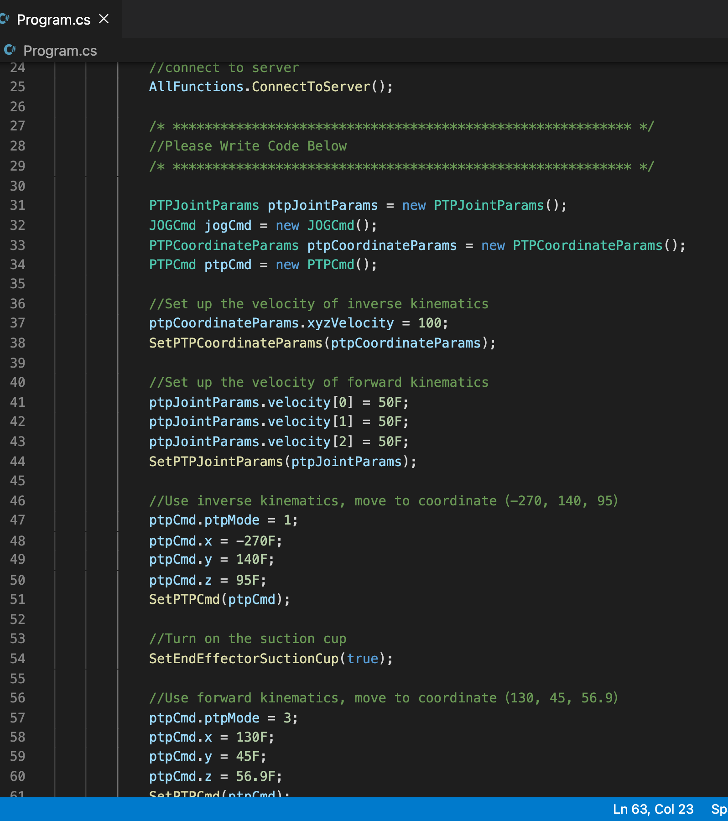
Coding Environment
Use Visual Studio Code as the coding environment with the .NET framework.
Supply high-level language and Application Programming Interface(API) using C#.
Provide Forward Kinematic and Inverse Kinematic functions that allow the users to control the mechanical arm based on motor rotation or the designated coordinates of the suction cup.
Provide grabbing object function via the suction cup
4/12/21
9
Notes:
9

Slide 10
Technical Side of Coding Environment
Using TCP/IP protocol between coding environment and simulator connection.
The coding environment will translate the high-level API into machine code that could be sent to the server which is hosted by the simulator.
The communication protocol of the machine code is open-sourced and provided in the documentation for developers or contributors to extend or improve the function.
4/12/21
10
Notes:
10

Slide 11
Project DEmo
04/10/2021
11
Notes:
11

Slide 12
Future Work
Support platforms besides MacOS, aiming for Windows, Android, and iOS platforms.
Increase the accuracy of the simulator and aim for an industry-level mechanical arm simulator.
4/12/21
12
Notes:
12

Slide 13
Reference
[1] Business Wire, “Robotics Market Forecast”, 2018, https://www.businesswire.com/news/home/20180911005588/en/Robotics-Market-Forecast-2x-Growth-in-Market-Size-by-2022-Technavio
[2] Shao-Chieh Lien, “3D-Physic-Simulating-Platform”, 2018, https://github.com/ShaoChiehLien/3D-Physic-Simulating-Platform
4/12/21
13
Notes:
13

